Slide 1
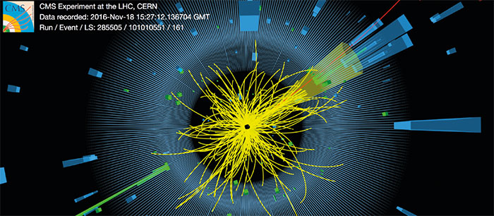
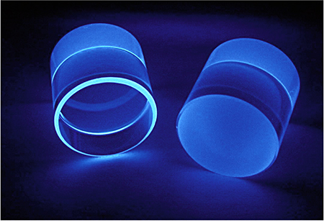
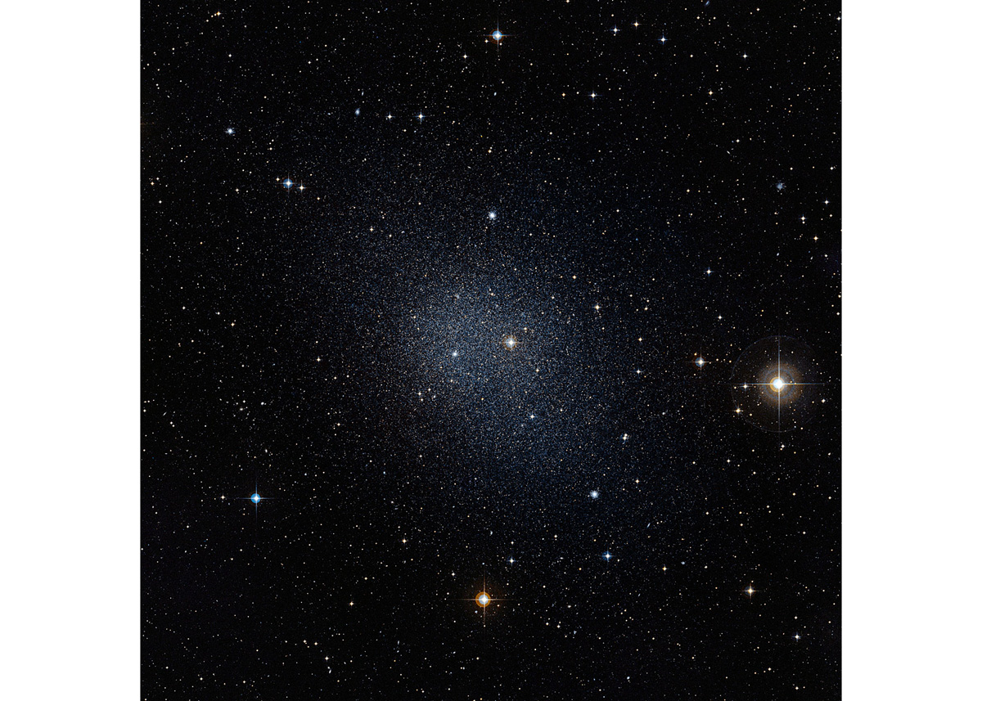
Searches for Dark Matter
Astroparticle Physics
Part 7 – WS 2019
Federico Ambrogi

Slide 2
Introduction
If we are finally convinced that Dark Matter exists… how do we search for it?

Slide 3
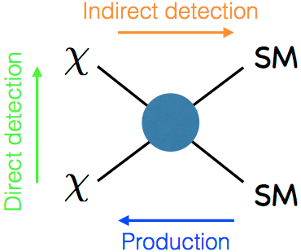
Introduction
If we are finally convinced that Dark Matter exists… how do we search for it?
«Make it»
Collide Standard Model (SM) particle, and hope to produce DM
«Shake it»
Hope that DM particles scatter onto some nuclei
«Break it»
Hope that DM particles interact and annihilate into SM particles
+ « Bake it »
invent nice theories to be tested experimentally

Slide 4
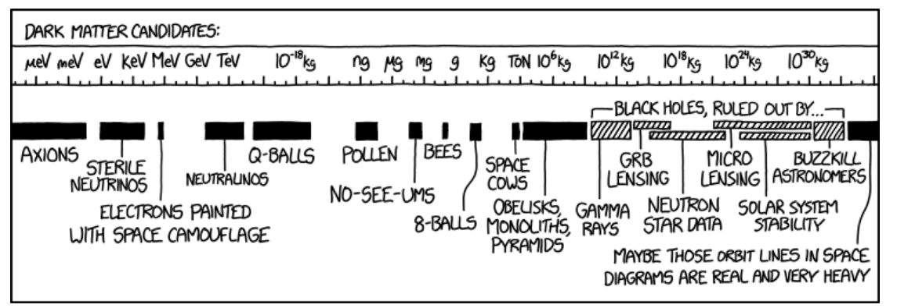
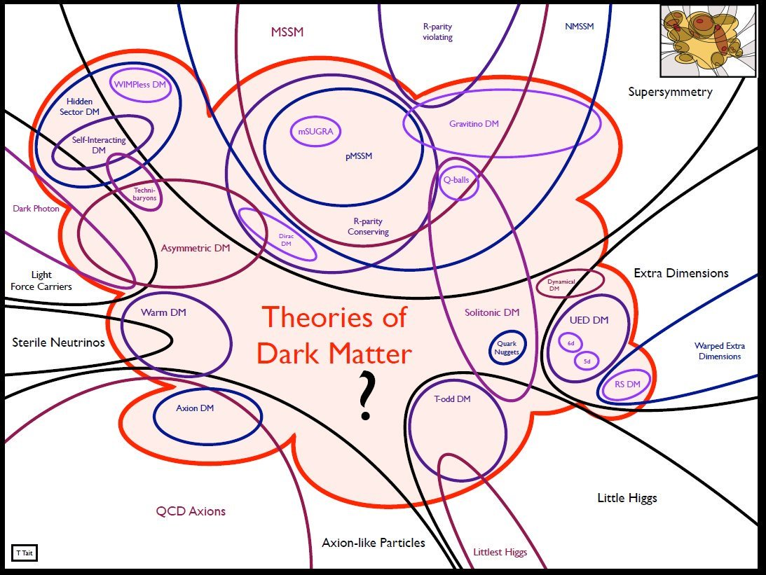
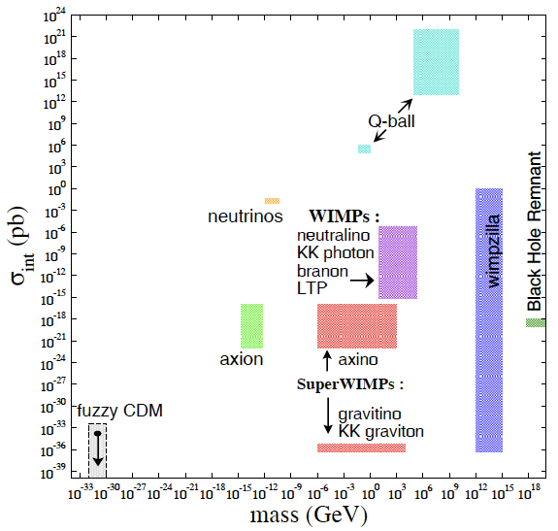
« Bake it »: Build DM Theories
“Bake it”
Many theories developed by theorists
Very rich phenomenology! (i.e. can search for DM with many different types of experiments)
Most of the times, full theories are too complicated to «make sense» easily out of experimental data ( → use simplified models )
We will take as an example: Supersymmetry

Slide 5
DM Candidates
Massive Compact Halo Objects (MACHOs): e.g. brown dwarfs, lonely planets, black holes populating the galactic halo. Not a sufficient number was not found e.g. in microlensing surveys
Primordial black holes (PBHs) produced before big bang nucleosynthesis came again into the focus of interest after the first observations of gravitational waves with unexpected high masses of 20-30 M ⊙. The total number of detected events is too small and PBHs in this mass range could only constitute ∼1%
Baryonic DM can be excluded by measurements of the primordial abundance of light elements produced in the big bang nucleosynthesis (2H, 3He, 4He, 7Li) and CMB power spectrum → Ωb ≈ 5%
The free-streaming length of the massive but very light-weight neutrinos would wash out the observed large-scale structure of galaxies in the Universe
The Standard Model of Particle Physics does not contain a single suitable dark matter candidate it is assumed that dark matter must be made of one (or more?) new particle(s)
Weakly interacting massive particles (WIMPs) e.g.
the lightest particle in Little Higgs models
Supersymmetric neutralinos
lightest Kaluza-Klein particle (LKP, extradimension models)
Others:
Axion-like Particle
Heavy right-handed neutrinos

Slide 6
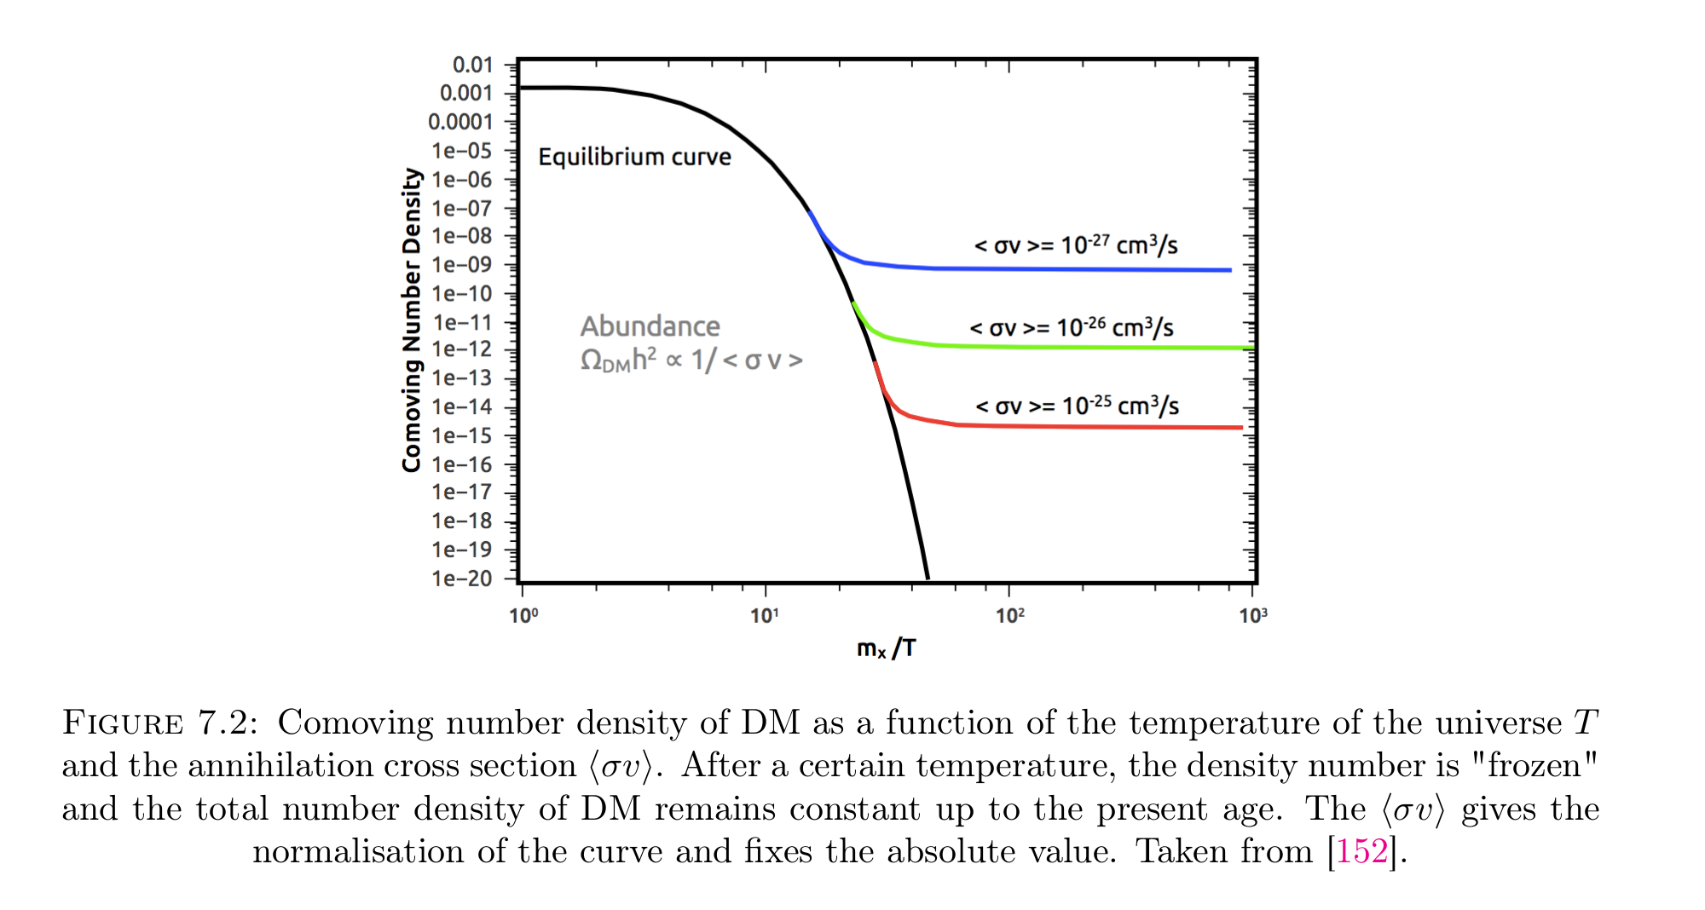
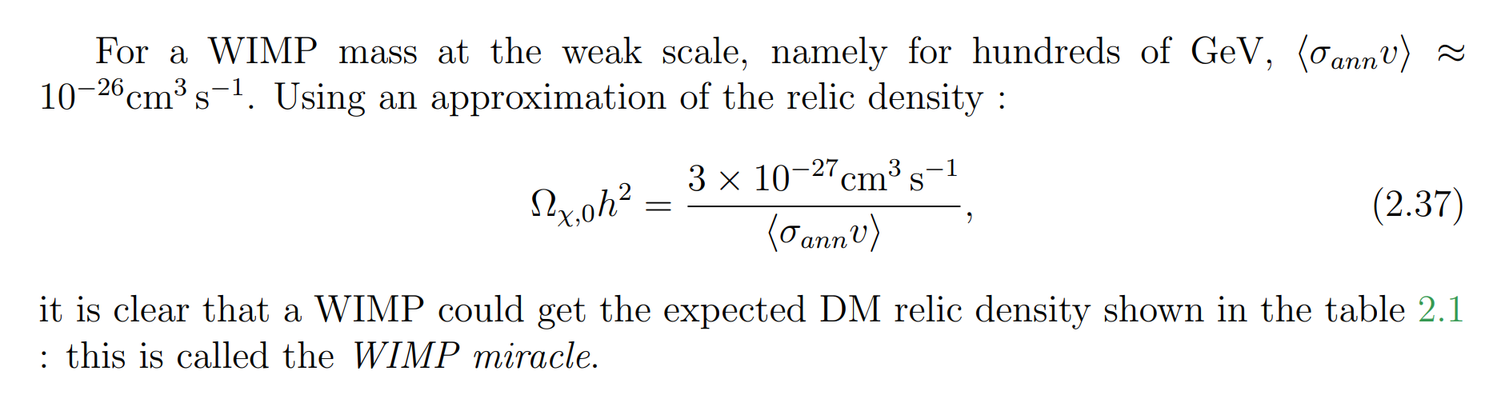
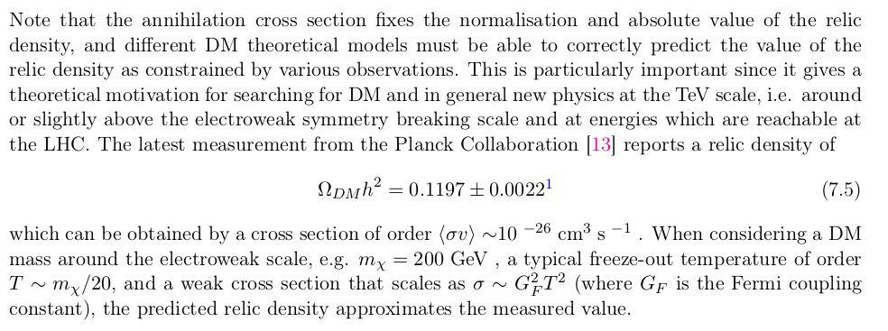
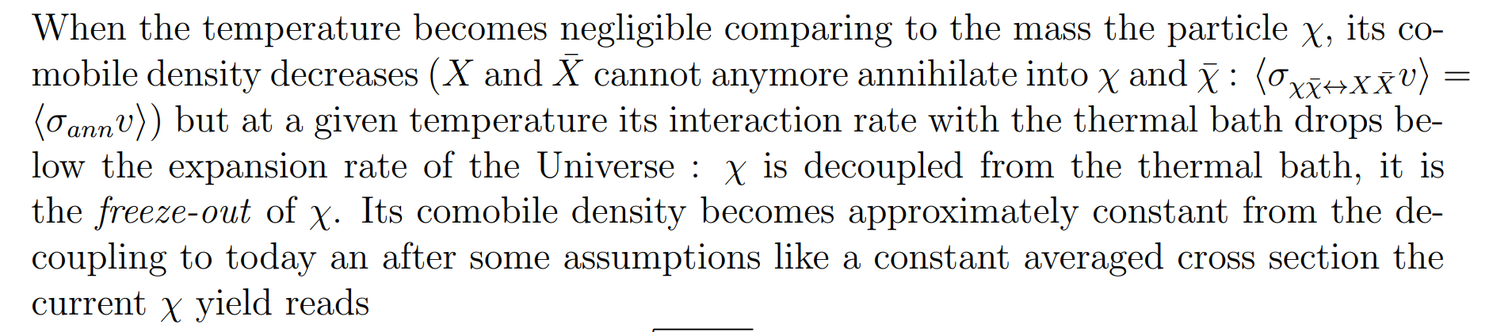
WIMP Miracle
Weakly Interacting Massive Particles (WIMPs) are assumed to be thermally produced in the early universe and are now moving with non-relativistic velocities, which makes them the prime candidate for “cold” dark matter
Density is frozen == relic density
→ Comoving density becomes constant
DM theories must be compatible with the constraints on the DM relic density

Slide 7
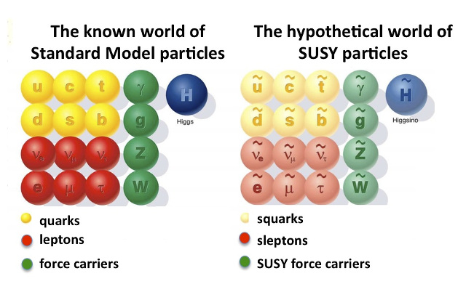
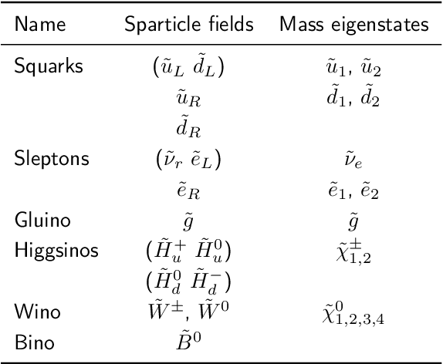
Example: Supersymmetry
Based on the assumption that there exists a fundamental symmetry that relates Fermionic and Bosonic particles
“(Still) our favourite template for a BSM theory:
● Theorists like it for a series of good reasons, and the good reasons tell us that some of the SUSY particles should be in the TeV region
● Experimentalists like it because of rich panoply of signatures, some of them abundantly produced at colliders, and easy to separate from backgrounds”
Possible Supersymmetric DM candidates
(LSP, Lightest Supersymmetric Particles):
Lightest
Gravitinos
Right-Handed Sneutrinos

Slide 8
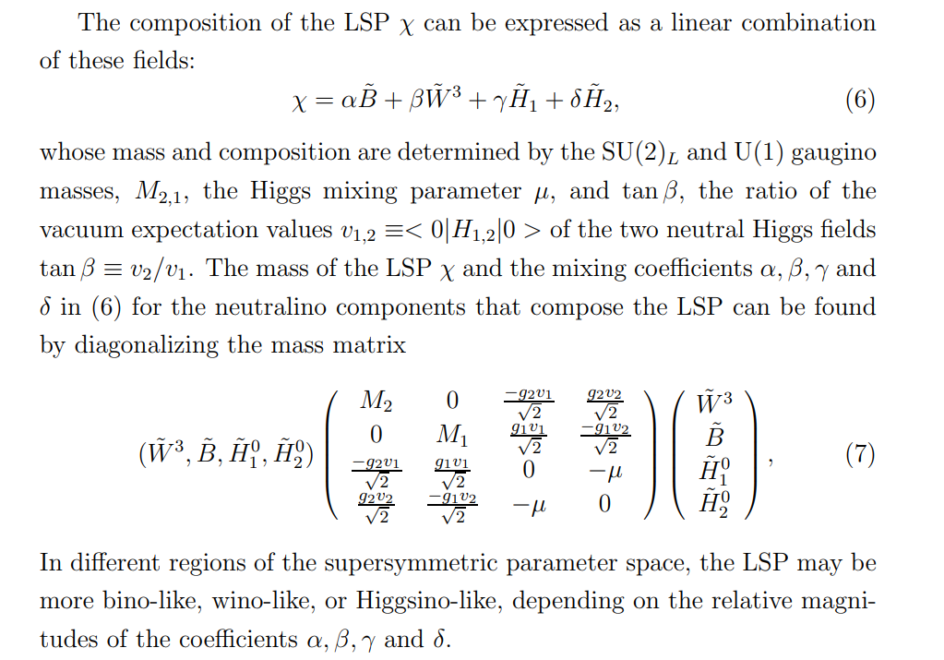
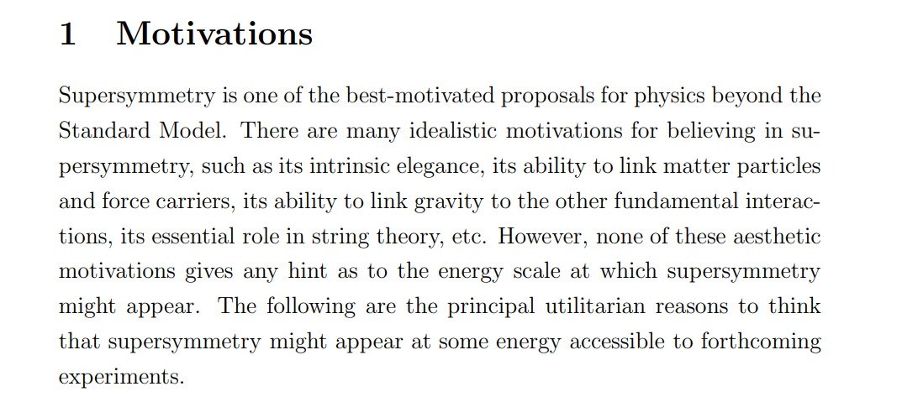
Example: Supersymmetry
https://arxiv.org/pdf/1001.3651.pdf
→ depending on the exact mixing or composition of the neutralinos:
different production rates, interactions/couplings to particles, decay modes

Slide 9


Slide 10

... replace with any other DM candidate

Slide 11
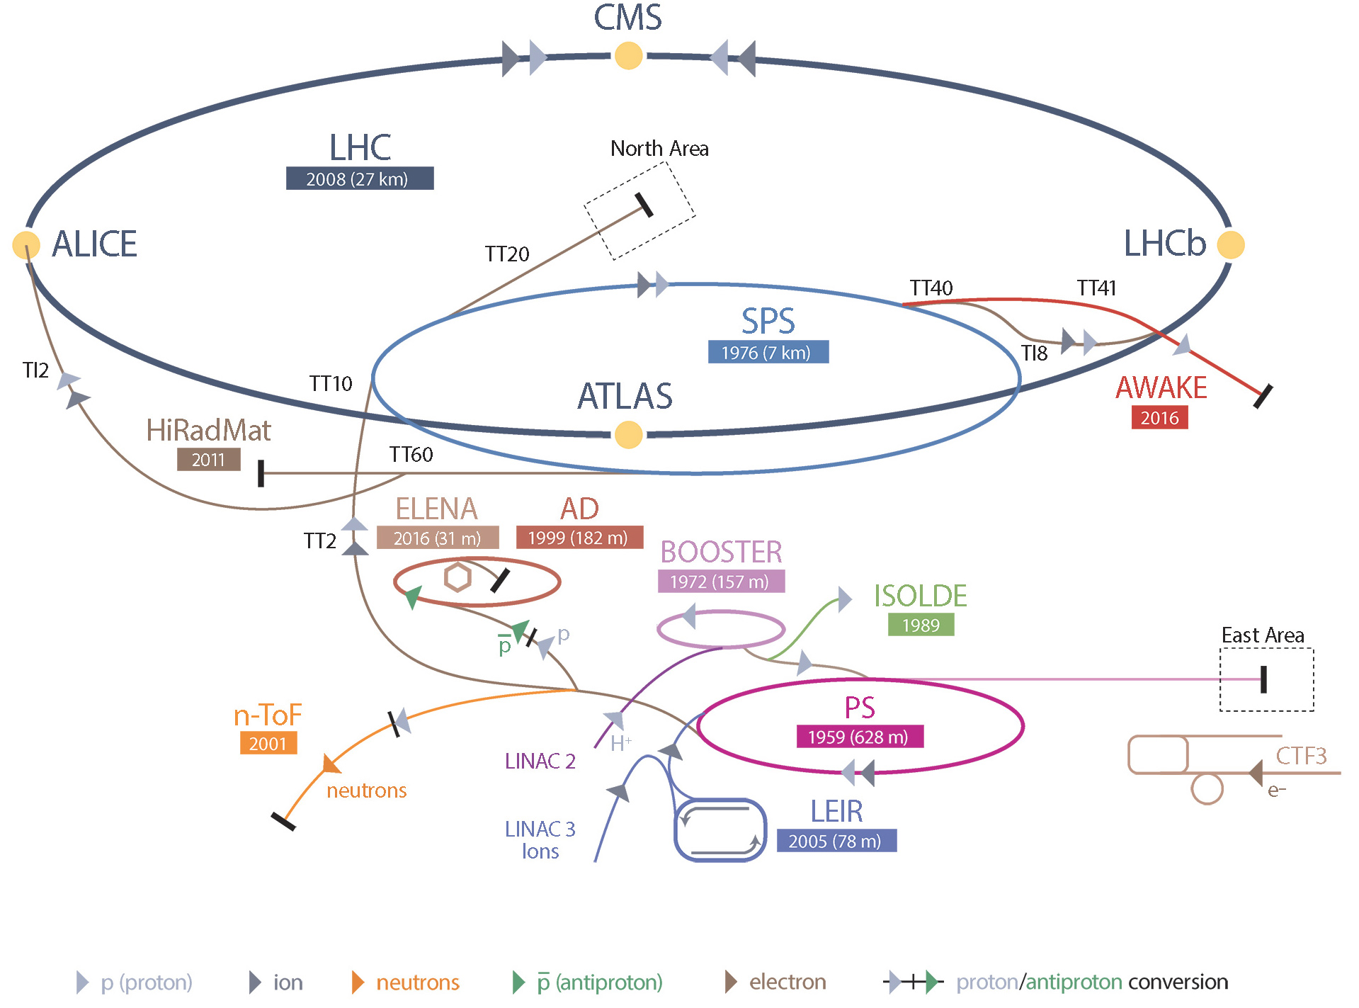
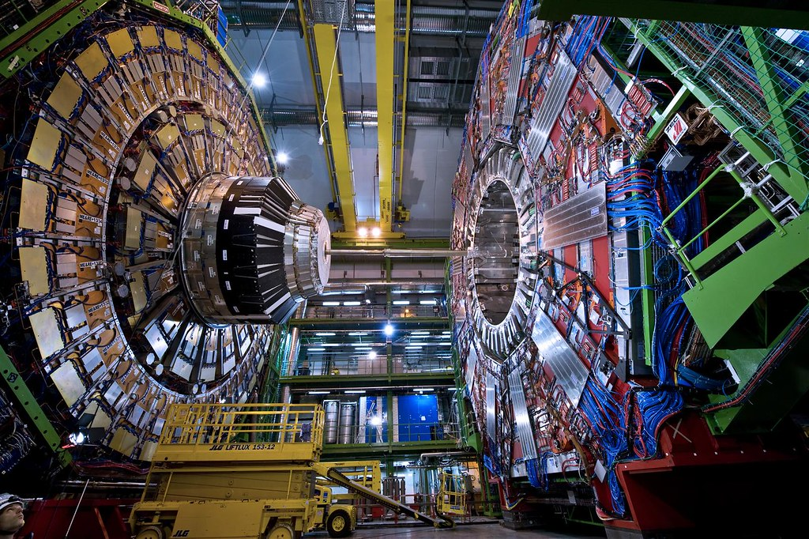

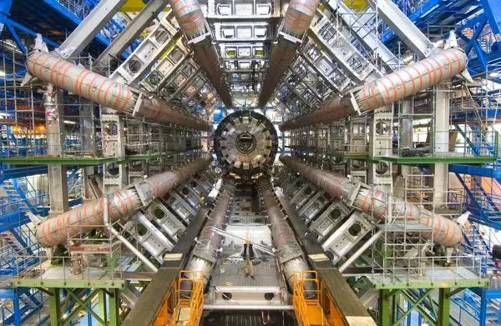

« Make it » : DM Searches at the LHC

Slide 12
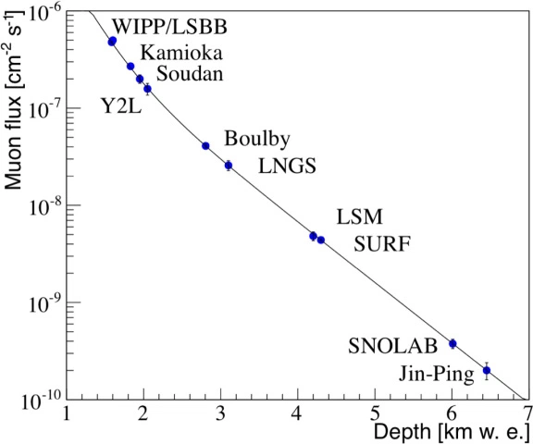
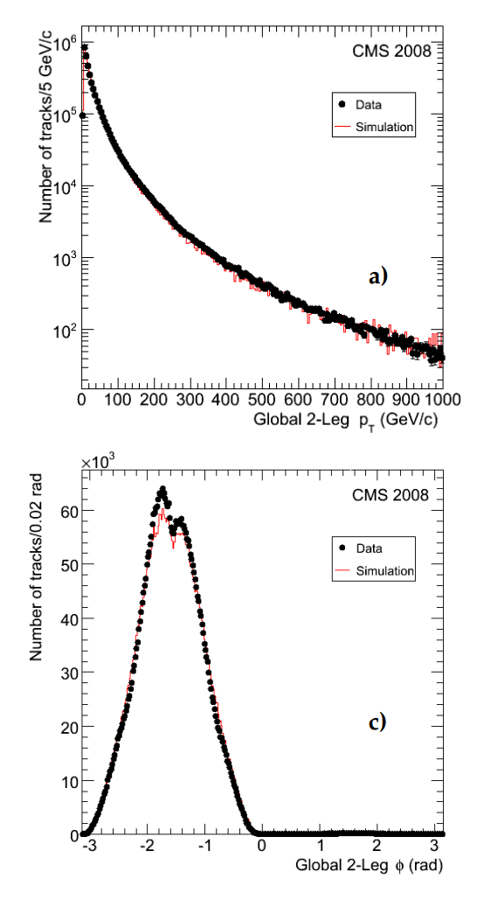
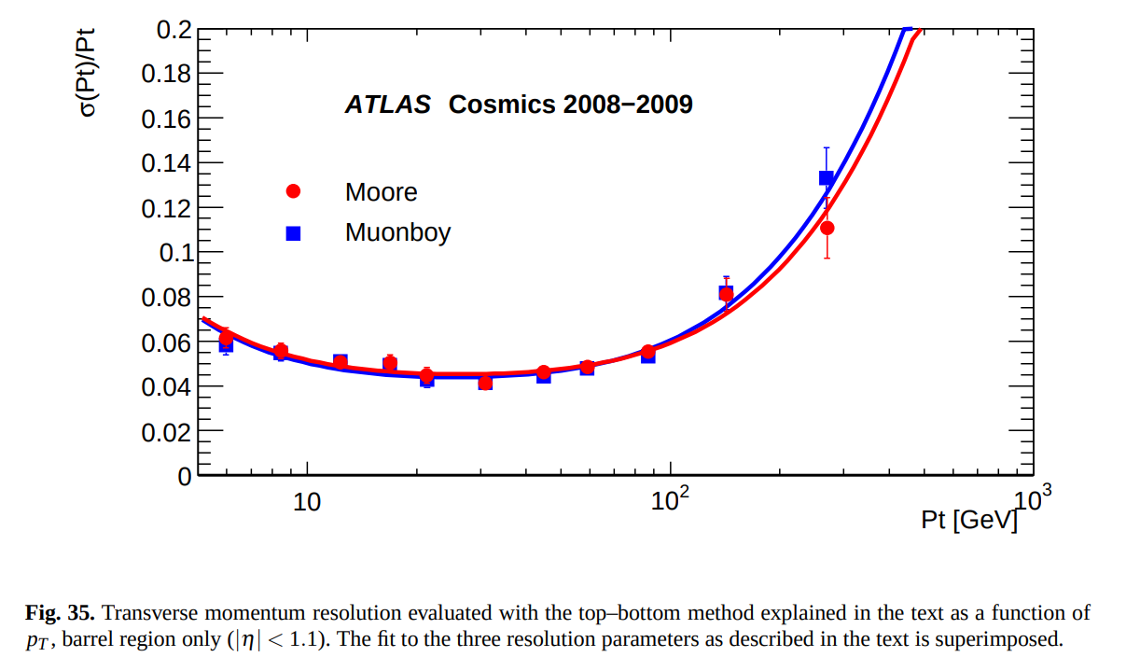
Cosmic Muons Studies at ATLAS/CMS
https://arxiv.org/pdf/0911.4994.pdf
https://arxiv.org/pdf/1006.4384.pdf
Muons arrive at sea level with an average flux of about 1 muon per square centimeter per minute
Can use cosmic muons to calibrate the detectors/ make studies
«The ATLAS detector at the Large Hadron Collider has collected several hundred million cosmic ray events during 2008 and 2009. These data were used to commission the Muon Spectrometer and to study the performance of the trigger and tracking chambers, their alignment, the detector control system, the data acquisition and the analysis programs»

Slide 13
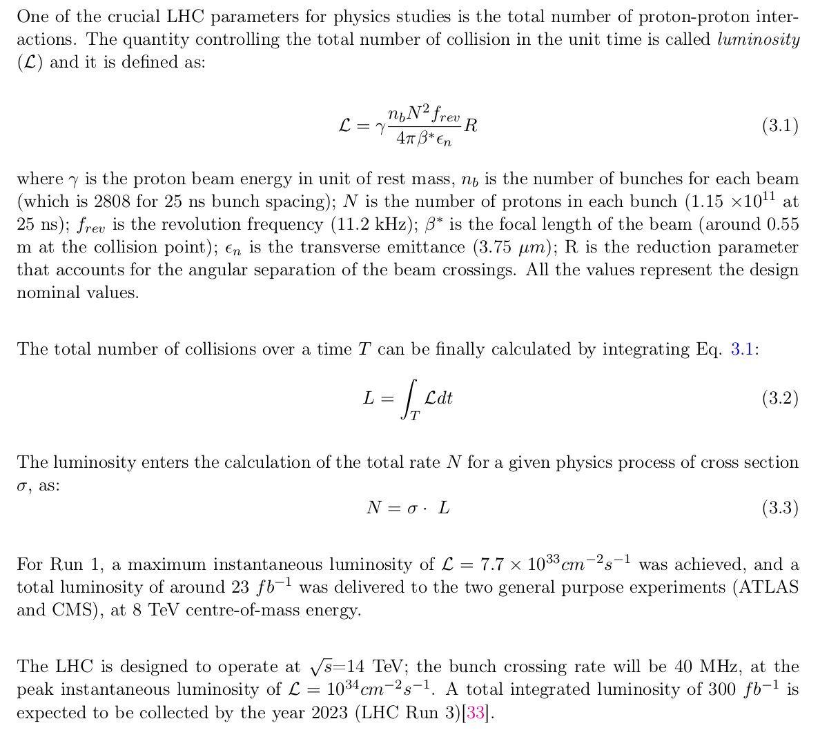
Some LHC Parameters
L= (iuntegrated) Luminosity
~ total amount of data that we collect at the detectors (which is more than the total amount of data that is really used for the data analyses)
Expected number of events for a given process with a production cross section sigma
-> depends on the particle physics model, e.g.
SM = Standard Model
BSM = Beyond Standard Model
(e.g. Supersymmetry)

Slide 14
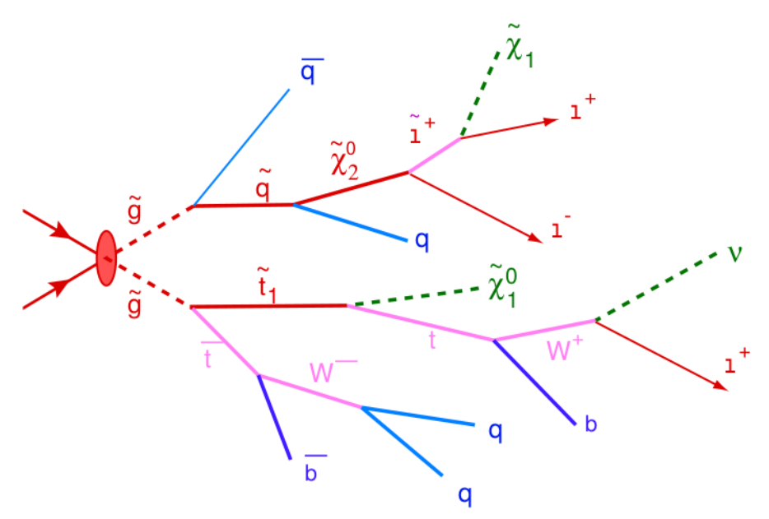
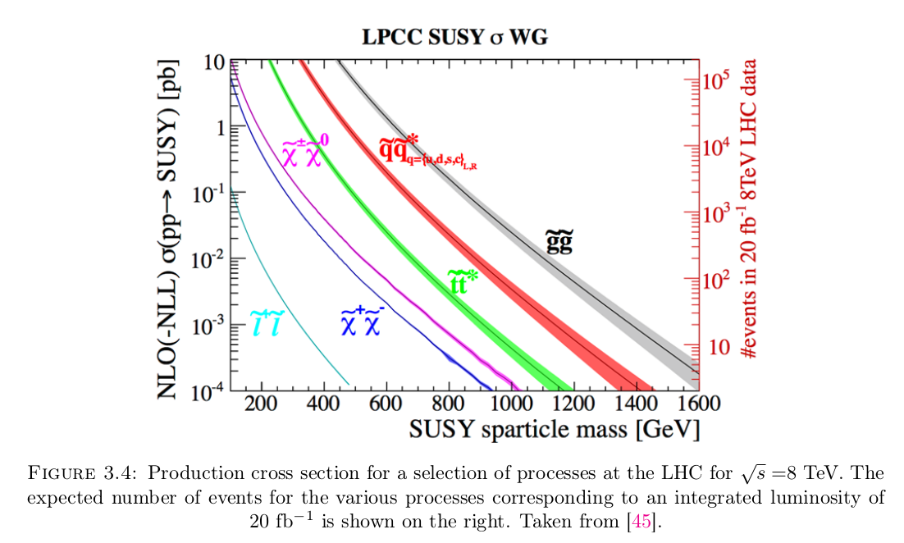
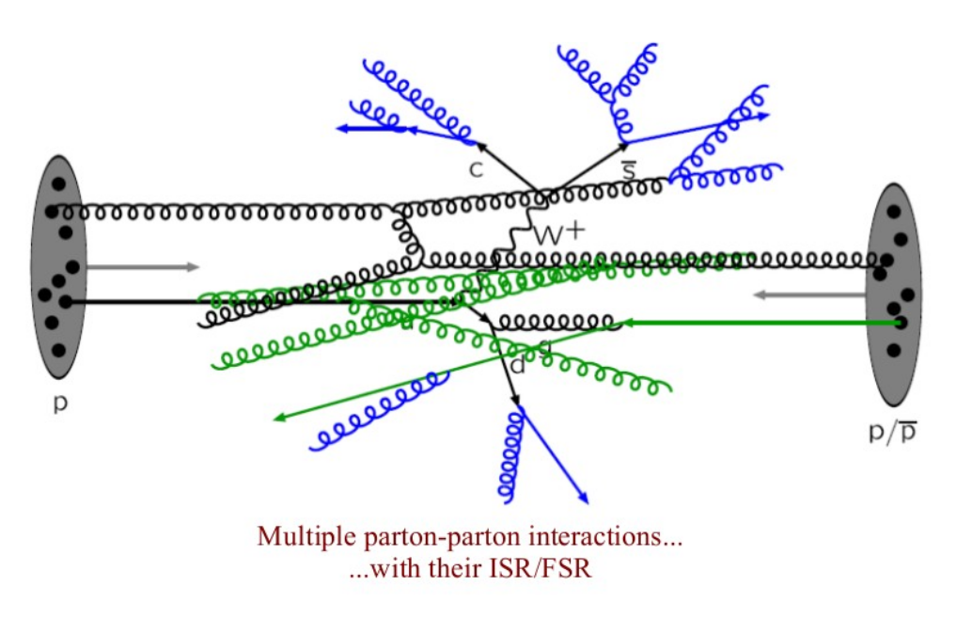
SUSY at the LHC
What SUSY theory predicts
for proton-proton (pp) collisions
What we would
like to see
Design of dedicated Searches
What really
happens…
Production cross section for some SUSY particles pair-production and expected number of events for 8 TeV centre-of-mass energy

Slide 15
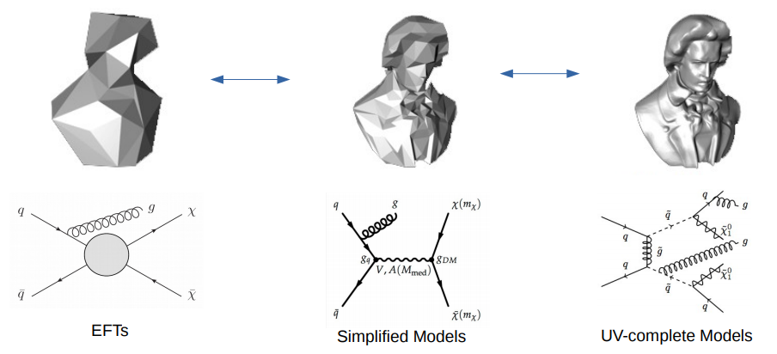
Simplified Models
Simplified Models are introduced by theorists to simplify the interpretations of the experimental data
They can only be used efficiently to design new searches (i.e. tune the data analysis to obtain better limits)
They are NOT realistic models
The results are valid ONLY under specific assumptions, and the results might hide some interesting underlying features
Nevertheless: very useful and widely used
https://indico.cern.ch/event/606690/contributions/2656661/attachments/1497909/2332228/kristian-hahn-LHCDM-TAUP2017.pdf

Slide 16
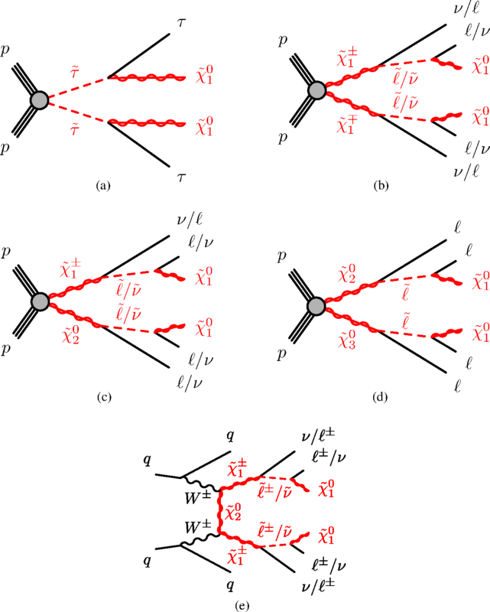
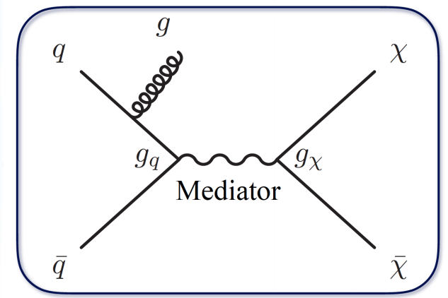
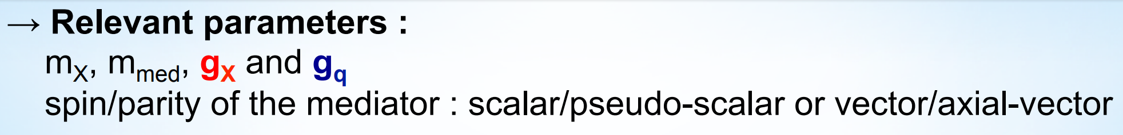
Simplified Models
SUSY Simplified Models
DM Simplified Models

Slide 17
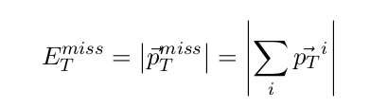

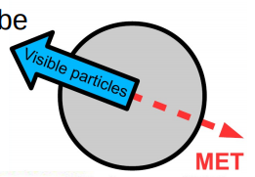
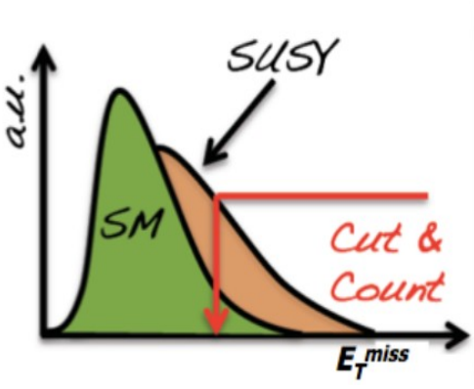
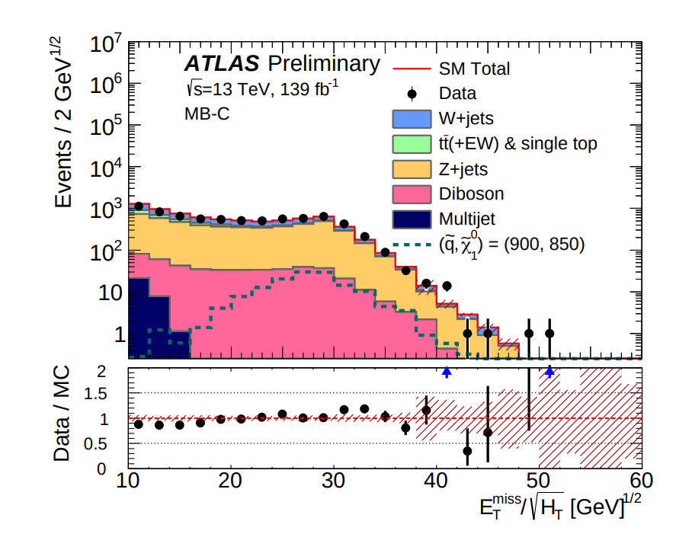
Example: SUSY at the LHC
Assumption: all the SUSY particles will eventually decay to the lightest Neutralino, which is the DM candidate, and it escapes detection since it does not interact with the detector
This will produce “missing energy” (MET) i.e. an energy imbalance in the event
?
What we “see”
What we do not “see”

Slide 18
Example: SUSY at the LHC
Assumption: all the SUSY particles will eventually decay to the lightest Neutralino, which is the DM candidate, and it escapes detection since it does not interact with the detector
This will produce “missing energy” (MET) i.e. an energy imbalance in the event
We expect a lot of missing energy in the events, that cannot be accounted for by SM neutrinos or particles that cannot be revealed by the detectors, systematics, detector acceptance, particle reconstructions efficiency etc.
However:
“detecting” the presence of such particles does not automatically mean that they are the Cosmological DM candidate
→ Can only state that they are stable while travelling through the detector (this is general of any DM search you perform at the colliders)
Evaluate accurately SM background
Make SUSY signal hypothesys to test with data

Slide 19
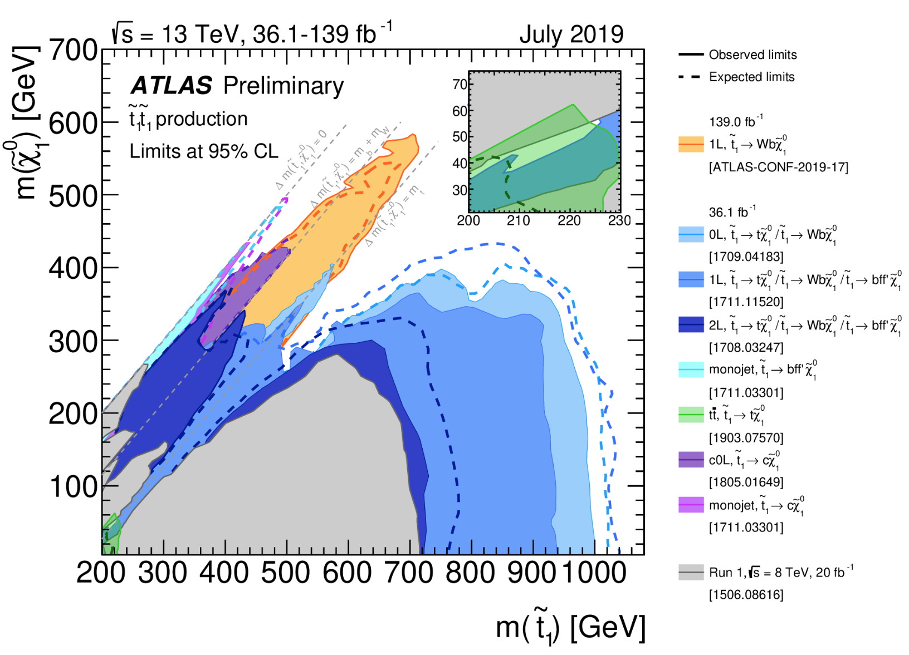
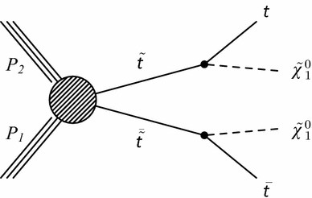
Example: SUSY at the LHC
Several searches targeting the same simplified model
The coloured regions are excluded by the corresponding search
i.e. the specific (stop-neutralino) mass parameters can be excluded experimentally by the search
To each (stop-neutralino) mass parameter you calculate a cross section upper limit for the stop-production (different for each search)

Slide 20
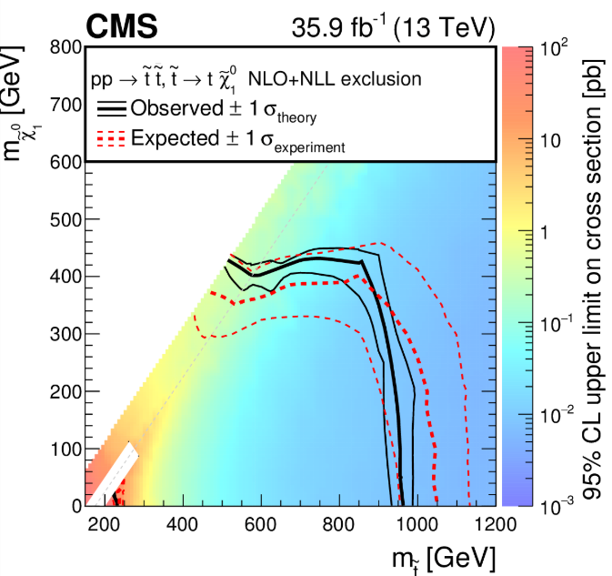
Example: SUSY at the LHC
To each (stop-neutralino) mass parameter you calculate a cross section upper limit for the stop-production (different for each search)

Slide 21
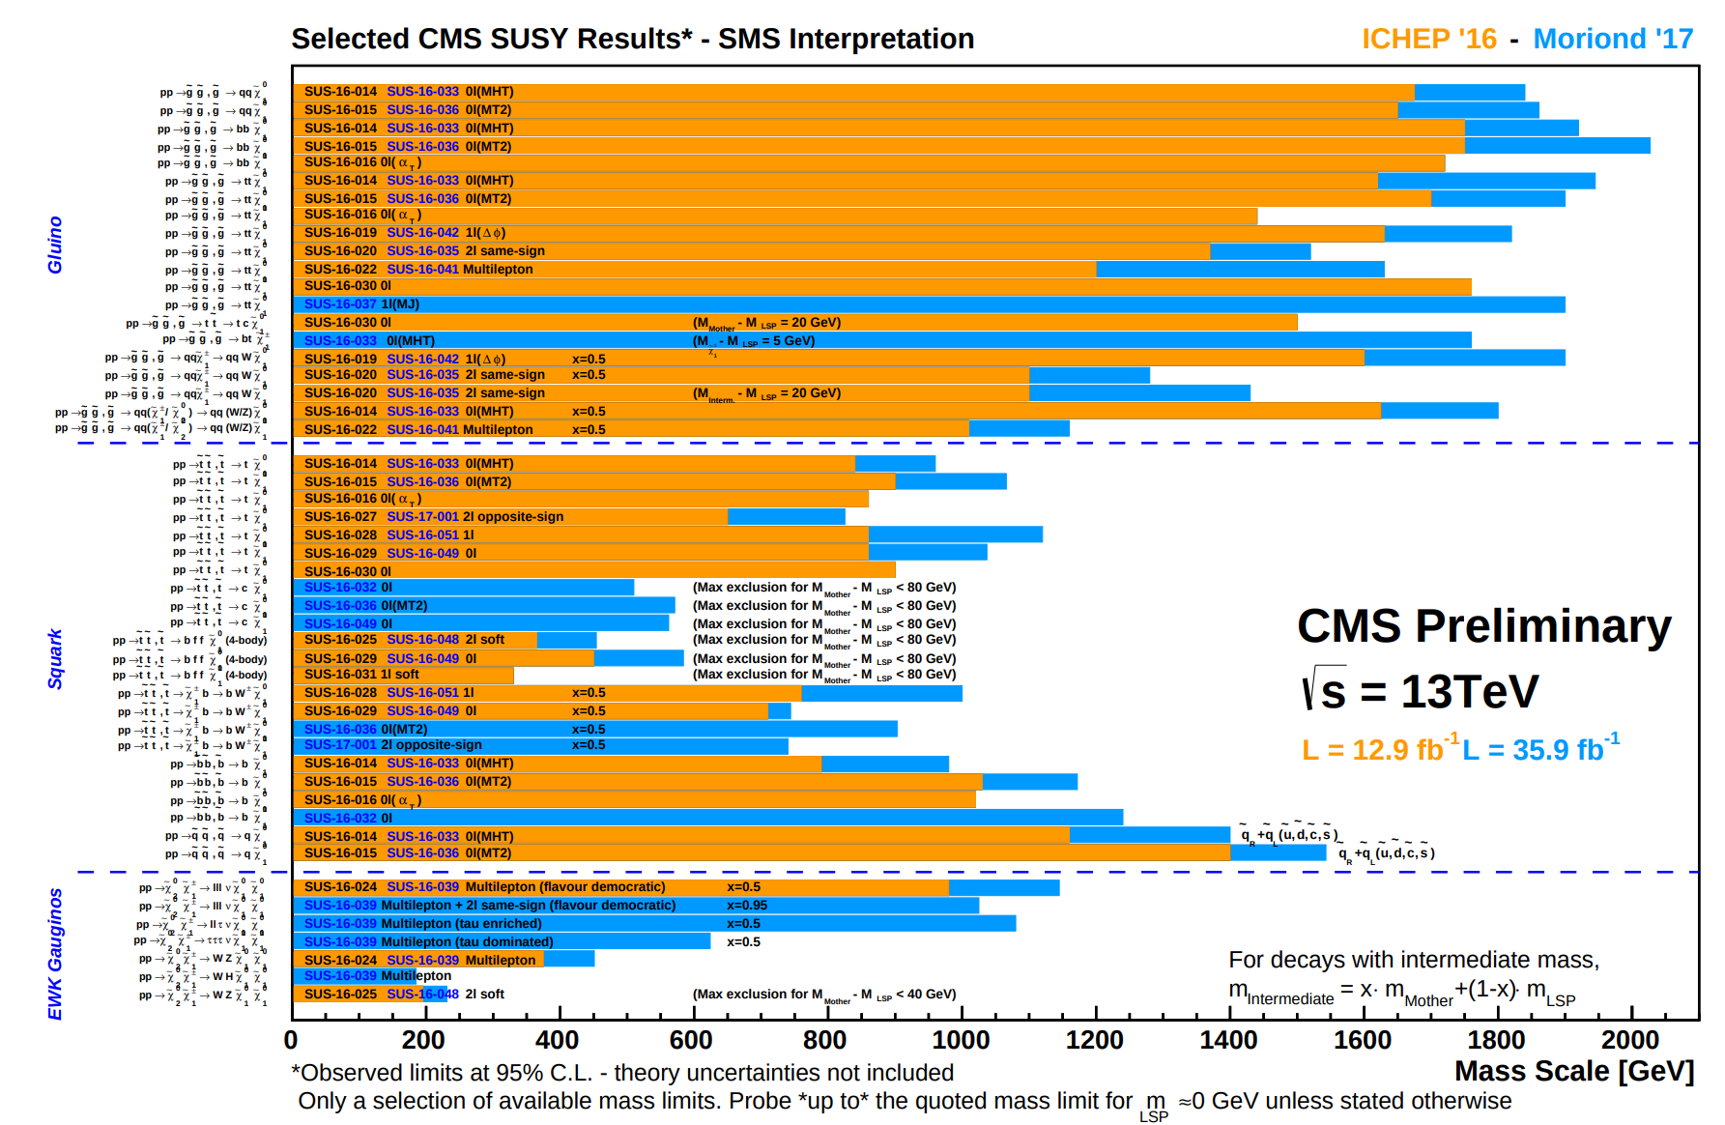
Example: SUSY at the LHC

Slide 22
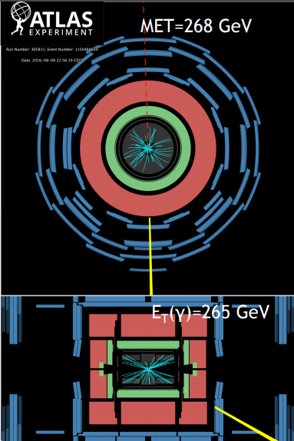
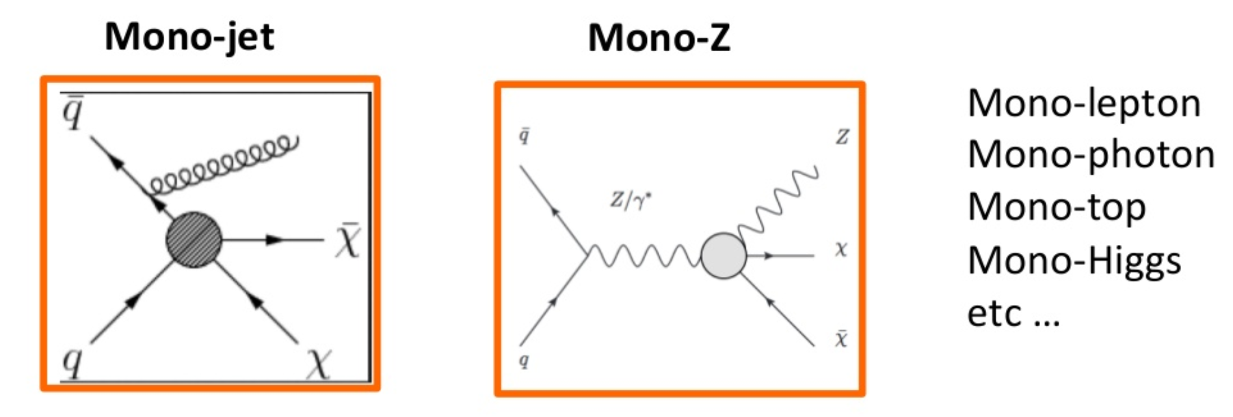
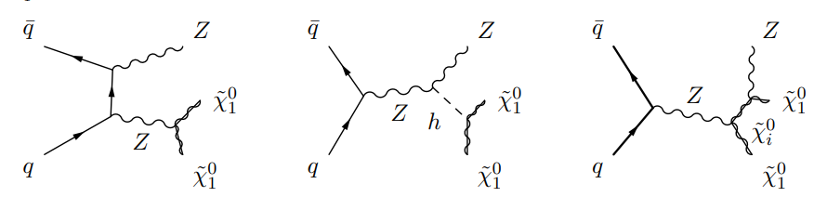
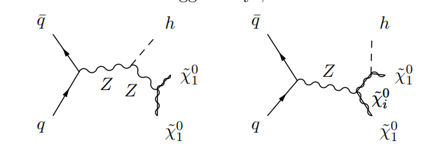
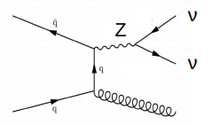
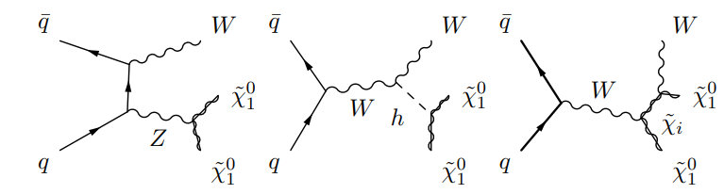
Example: direct DM production and mono-X Searches
Idea: DM direct production plus “something”
Example: Mono-jet SM irreducible background
Example for SUSY

Slide 23
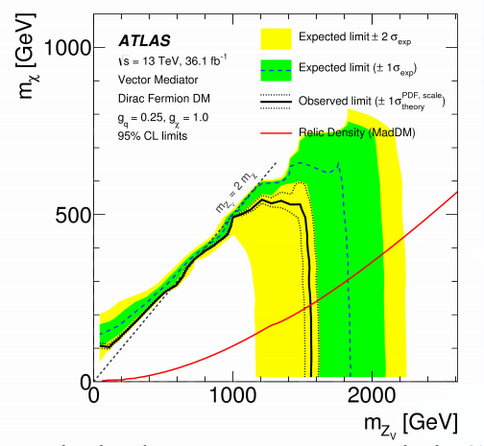
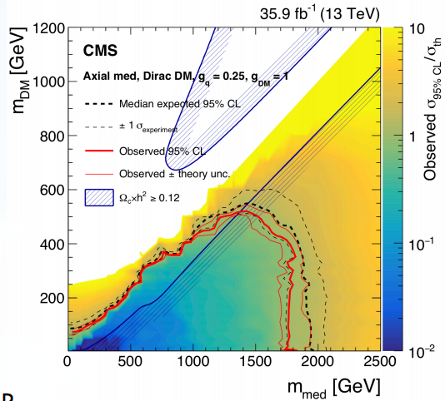
Example: direct DM production and mono-X Searches
→ Using DM simplified models: put limits on the DM and mediator mass for fixed couplings

Slide 24
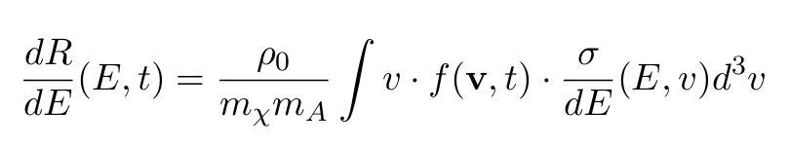
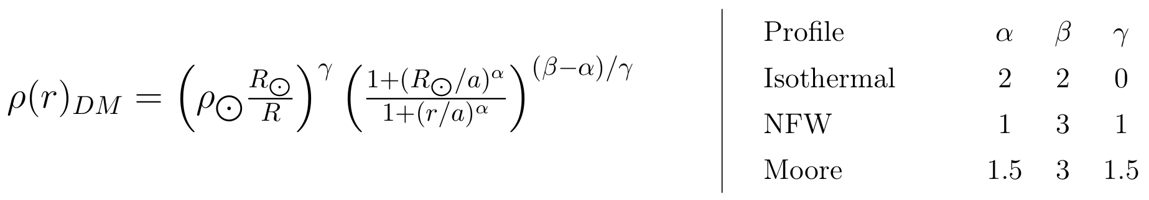
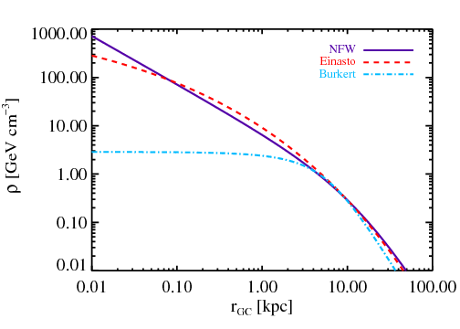
« Shake it » : DM Direct Detection
Idea: the Earth travels through the DM Milky Way’s halo, and DM particles might scatter off (heavy) nuclei
In general, the expected event rate can be expressed as
Models for the Halo densities
“The precise shape of the density profile for r → 0 is unknown and different possibilities were derived from N-body simulations. Some solutions exhibit a flat core, others are more cuspy. Recent studies of dwarf galaxies indicate that the “cuspyness” of the density profile depends on the star formation rate which drives fluctuations in the gravitational potential: galaxies with longer lasting star formation have more shallow dark matter cores”
https://arxiv.org/pdf/1903.03026.pdf

Slide 25
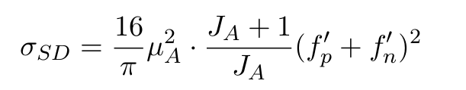
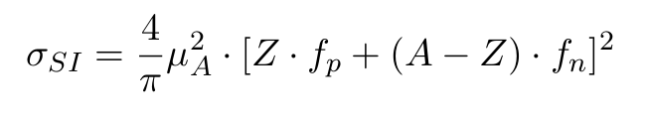
« Shake it » : DM Direct Detection
Idea: the Earth travels through the DM Milky Way’s halo, and DM particles might scatter off (heavy) nuclei
In general, the expected event rate can be expressed as
Particle Physics: Scattering Cross Sections
Spin dependent cross section (i.e. different for protons and neutrons)
Spin independent cross section (i.e. same for protons and neutrons)

Slide 26
DM Direct Detection
Key points for DM Direct detection:
DM induced recoils energies are very small ( eV ~ keV range )
Many natural signals can mimic DM scattering e.g. background neutrinos (Sun, radioactive decays…)
Accurate signal/background discrimination needed
On the side: they can study DM & other physics at the same time (e.g. neutrino physics, extremely rare radioactive decays)
Limitation: neutrino floor
Experimental strategies:
Noble liquid targets
[ DARWIN, LUX, Panda-X, XENON, XENON1T, XENONnT ]
Cryogenic Crystal Targets
[ CRESST(II,III) , EDELWEISS, SuperCDMS]
Others: e.g. bubble chambers, NaI crystals
[ANAIS, DAMA/LIBRA, COSINE, PICO…]

Slide 27


DAMA/LIBRA and the Annual Modulation

Slide 28

DAMA/LIBRA and Annual Modulation
The data of the new DAMA/LIBRA–phase2 confirm a peculiar annual modulation in the (1–6) keV energy region:
the single-hit events show a clear cosine-like modulation
2) the measured period is equal to (0.999± 0.001) yr well compatible with the 1 yr period as expected for the DM signal
3) the measured phase (145 ± 5) days is compatible with the roughly ≃ 152.5 days expected for the DM signal
4) the modulation is present only in the low energy (1–6) keV interval and not in other higher energy regions
5) the modulation is present only in the single-hit events, while it is absent in the multiple-hit ones as expected for the DM signal
6) the measured modulation amplitude in NaI(Tl) target of the single-hit scintillation events in the (2–6) keV energy interval, for which data are also available by DAMA/NaI and DAMA/LIBRA–phase1, is: (0.0103 ± 0.0008) cpd/kg/keV (12.9 σ C.L.).
No systematic or side processes able to mimic the signature (...) has been found
Thus, on the basis of the exploited signature, the model independent DAMA results give evidence at 12.9σ C.L. (over 20 independent annual cycles and in various experimental configurations) for the presence of DM particles in the galactic halo

Slide 29


LUX

Slide 30
LUX
LUX is a dual-phase liquid/gas xenon Time Projection Chamber (TPC)
When a WIMP (or other particle) interacts with one of the xenon atoms in the liquid portion of the detector, it causes the xenon nucleus to recoil (S1 signal).
The recoil leads to a burst of scintillation light and to the ionization of the surrounding xenon atoms, leading to the liberation of “ionization electronsThey drift to the top of the detector (electric field) where they encounter the gas-liquid interface.
They produce a second burst of light through electroluminescence (S2).
The resultant photons from each burst of light are detected by 122 Photomultiplier Tubes (PMTs), split between the top and bottom of the detector.
The two signals, S1 and S2, are separated by the drift time of the electrons, from which we can infer the depth of the event.
Combining this information with the geometrical patterns produced by the number of photoelectrons detected by each PMT, the three dimensional position can be reconstructed for each event. This position information is vital for discrimination between signal and background since the xenon self-shielding causes most of the background events to be concentrated near the walls of the detector. Uniform backgrounds such as the decays of radioactive elements contaminating the xenon itself, will produce electron-recoils rather than nuclear recoils in the detector.
These events can be distinguished from that of nuclear recoils based on the ratios of their S1 and S2 signals.
[ For Xenon1T: the electrons are drifted by an electric field to the liquid-gas interface with a speed of about 2 mm/μs. ]

Slide 31


LUX

Slide 32

XENON1T
3.2 tons of ultra radio-pure liquid Xenon
Fiducial volume of about 2 tons
The detector is housed in a 10 m water tank that serves as a muon veto
The TPC is 1 m in diameter and 1 m in height
“In April 2019, based on measurements performed with the XENON1T detector, the XENON Collaboration reported in Nature the first direct observation of two-neutrino double electron capture in xenon-124 nuclei,
The measured half-life of this process, which is several orders of magnitude larger than the age of the Universe, demonstrates the capabilities of xenon-based detectors to search for rare events and showcases the broad physics reach of even larger next-generation experiments.
This measurement represents a first step in the search for the neutrinoless double electron capture process, the detection of which would provide valuable insight into the nature of the neutrino and allow to determine its absolute mass”

Slide 33



CRESST
CRESST (Cryogenic Rare Event Search with Superconducting Thermometers)
The CRESST-III experiment operates scintillating CaWO4 crystals as cryogenic calorimeters, simultaneously measuring a phonon/heat and a scintillation light signal.
A distinctive feature of the phonon signal is a precise determination of the energy deposited in the crystal, independent from the type of particle interaction.
This property, in combination with a low energy threshold, makes cryogenic calorimeters particularly suited for low-mass dark matter detection.
Contrary to the phonon signal, the scintillation light strongly depends on the type of particle interaction, yielding event-by-event discrimination between the dominant background (β/γ-interactions) and the sought-for nuclear recoils.

Slide 34
CRESST
CRESST is located in the Laboratori Nazionali del Gran Sasso (LNGS) underground laboratory in central Italy which provides an overburden against cosmic radiation with a water equivalent of 3600 m
Remaining muons are tagged by an active muon veto with 98.7% geometrical coverage
In addition, the experimental volume is protected by concentric layers of shielding material comprising - from outside to inside - polyethylene, lead and copper.
The polyethylene shields from environmental neutrons, while lead and copper suppress γ-rays.
A second layer of polyethylene inside the copper shielding guards against neutrons produced in the lead or the copper shields. A commercial 3He/4He-dilution refrigerator provides the base temperature of about 5 mK. Cryogenic liquids (LN2 and LHe) are refilled three times a week causing a down-time of about 3 h per refill.
https://youtube/uz177q5l82Q

Slide 35

Recent Results

Slide 36


Recent Results

Slide 37



CEνNS – Coherent Neutrino Scattering and Neutrino Floor
When a neutrino scatters off a nucleus the interaction depends on the neutrino-nucleon interaction
for small momentum transfer it does not resolve the internal structure of the nucleus (i.e. does not see nucleons)
the neutrino scatters off the nucleus as a whole
give rise to a coherent enhancement of the scattering cross-section
neutral-current process: experimental signature is nuclear recoils with energies of only few eV to keV.
… Essentially the same happens
in the case of WIMPS !
https://arxiv.org/pdf/1904.01155.pdf

Slide 38

CEνNS – Coherent Neutrino Scattering and Neutrino Floor
For a vanishing momentum transfer between the incoming WIMP and the target nucleus an analogous coherent enhancement of the scattering cross-section is expected.
the CEνNS cross-section scales with the total neutron number N2
the assumed dark matter coupling to both protons and neutrons is non-negligible and approximately equal
the cross-section for WIMP-nucleus scattering scales with the square of the total nucleon number A2 instead
https://arxiv.org/pdf/1904.01155.pdf
Dark matter searches will run into an irreducible CEνNS background (“neutrino floor”)
This background is induced by neutrinos from astrophysical sources, such as the sun, or the diffuse supernova neutrino background (DSNB)
Since the sole detectable signal for both CEνNS and WIMP scattering is a low energy nuclear recoil it is impossible to distinguish the two

Slide 39

« Break it » : DM Indirect Detection
Idea: DM particles can interact and produce visible SM particle
Ideal environments: regions with large expected DM density
Galactic centre
Dwarph Spheroidal Galaxies
(very large mass-to-light ratio or J-factor)

Slide 40



Dwarf Spheroidal Galaxies (Milky Way Satellites)

Slide 41

« Break it » : DM Indirect Detection

Slide 42

« Break it » : DM Indirect Detection
What is typically detected and analyzed

Slide 43


« Break it » : DM Indirect Detection

Slide 44


Flux at Detection and DM Annihilation Simplified Channels

Slide 45

Flux at Detection and DM Annihilation Simplified Channels

Slide 46

Flux at Detection and DM Annihilation Simplified Channels

Slide 47

Flux at Detection and DM Annihilation Simplified Channels
Spectra are assumed to be largely independent of the specific (simplified model) chosen

Slide 48


Fermi LAT Results

Slide 49

Charged CR Propagation Effects
The propagation of charged CR in the galaxies depends strongly on the parametrization of the galaxy
In particular, the modelization of source points e.g. Pulsars seems very important, as well as the dense region in the inner part
the predicted flux at Earth

Slide 50
How to Put Everything (as much as we can) Together
Theorists develop tools that allow to calculate accurate theory predictions (e.g. Annihilation cross sections, detection rates, fluxes, relic densities) that can be compared with the latest experimental results

Slide 51



How to Put Everything (as much as we can) Together
Theorists develop tools that allow to calculate accurate theory predictions (e.g. Annihilation cross sections, detection rates, fluxes, relic densities) that can be compared with the latest experimental results

Slide 52

http://pdg.lbl.gov/2019/reviews/rpp2018-rev-astrophysical-constants.pdf

Slide 53


